Slide 1
Lab 4
Chaojie Zhang

Slide 2
Reading
Backpropagation:
http://galaxy.agh.edu.pl/~vlsi/AI/backp_t_en/backprop.html
https://mattmazur.com/2015/03/17/a-step-by-step-backpropagation-example/

Slide 3
HPC
-> Greene -> Google Cloud Platform (GCP)
200 GPU hours for everyone. Email us if that is no enough.
HW 2 is more difficult! It takes time to request a GPU! Please start early!
Advanced HPC topic next week.

Slide 4
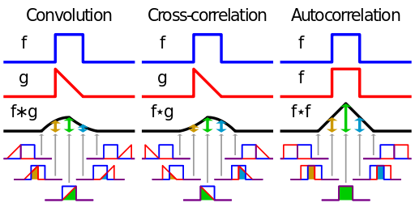
Convolution Cross-correlation Auto-correlation
Convolution describes the response of a linear and
time-invariant system to an input signal.
The inverse Fourier transform of the pointwise product in frequency space.
Cross-correlation is a measure of similarity of two signals.
It can be used for finding a shift between two signals.
Auto-correlation is the cross-correlation of a signal with itself.
It can be used for finding periodic signals obscured by noise.
http://en.wikipedia.org/wiki/Convolution

Slide 5
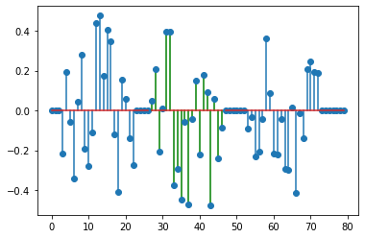
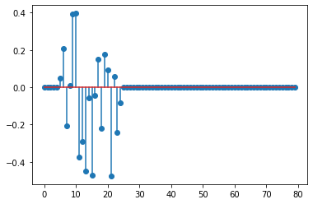
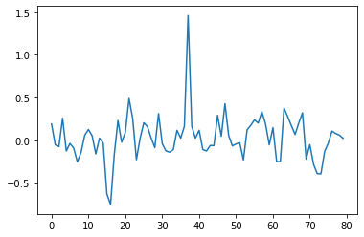

Convolution
The Convolution in deep learning is different from Convolution in signal processing.
The Convolution in deep learning is actually Cross-Correlation in signal processing.
Cross-Correlation in signal processing can be used to find similar pattern.
=

Slide 6
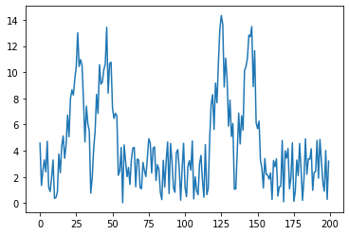
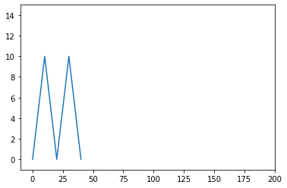
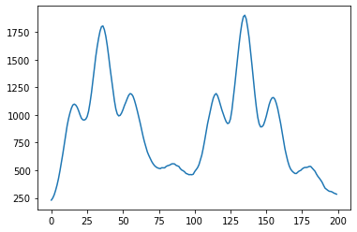
Cross-Correlation in Signal Processing
=

Slide 7
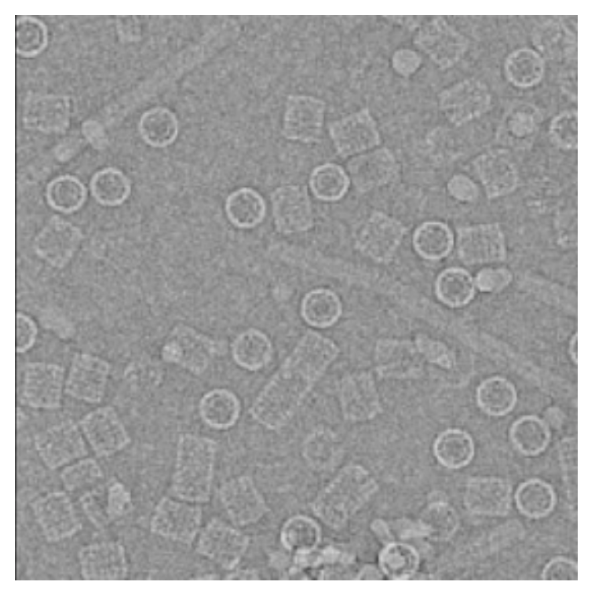
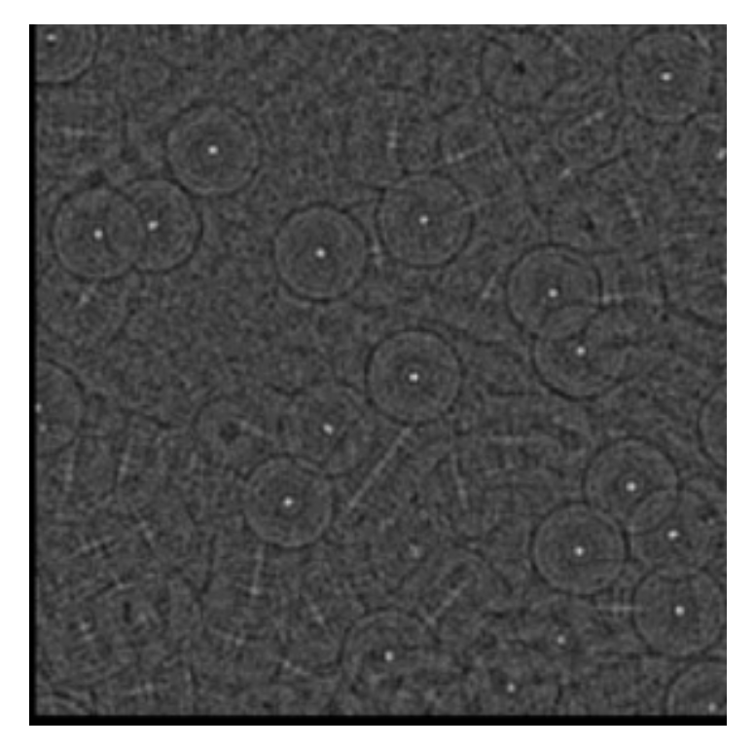
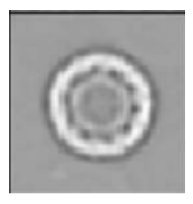
Cross-Correlation in Signal Processing
=
Reference: https://www.youtube.com/watch?v=WkYLgj_D6dM

Slide 8
Convolution

Slide 9
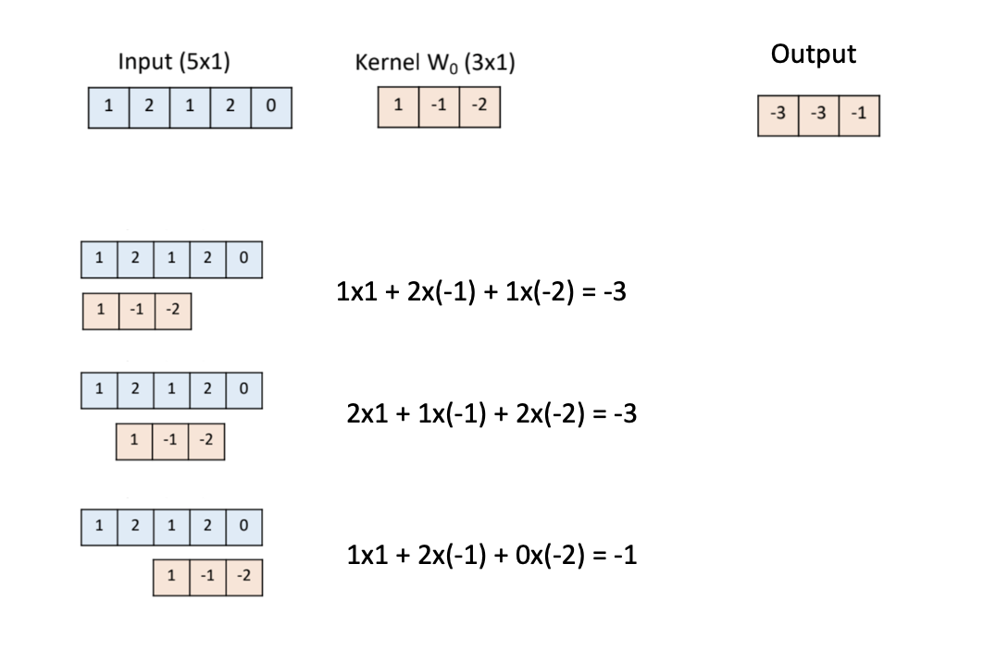

Slide 10
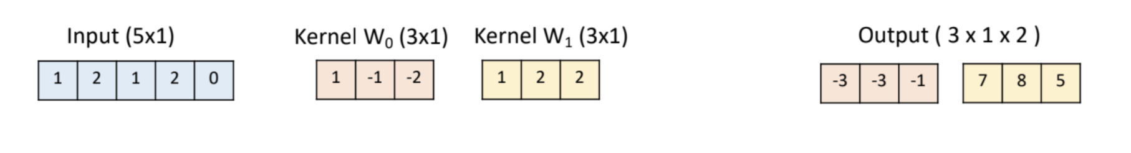

Slide 11
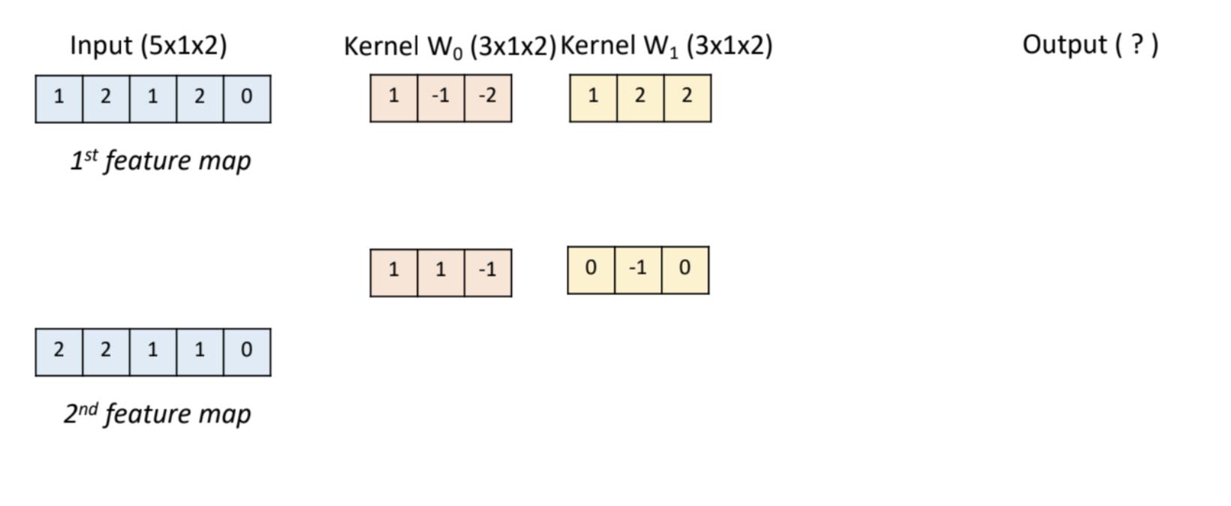

Slide 12
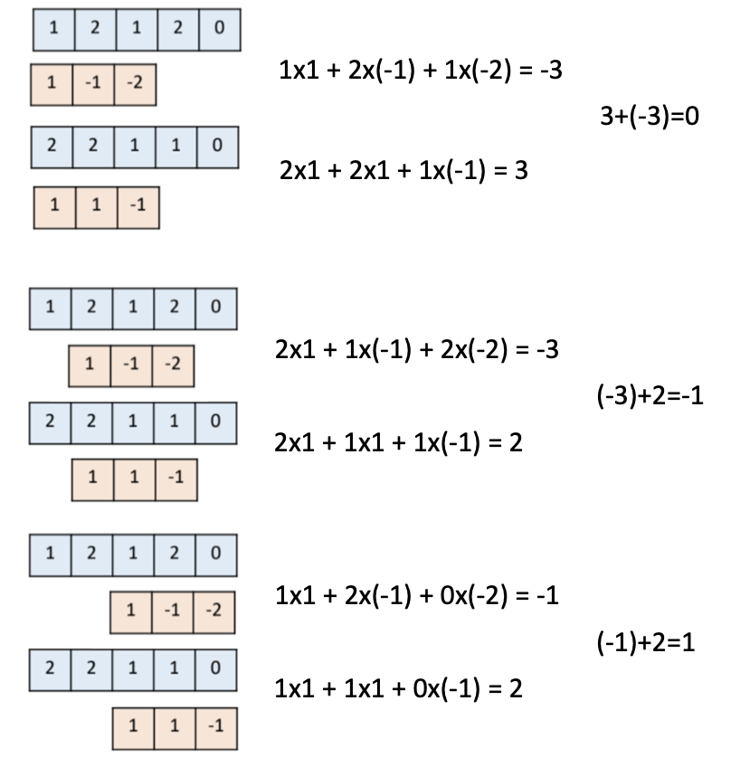
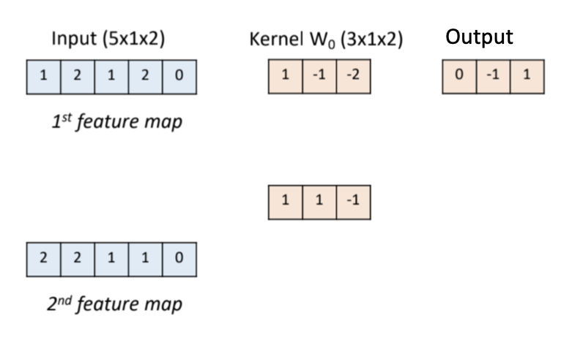

Slide 13
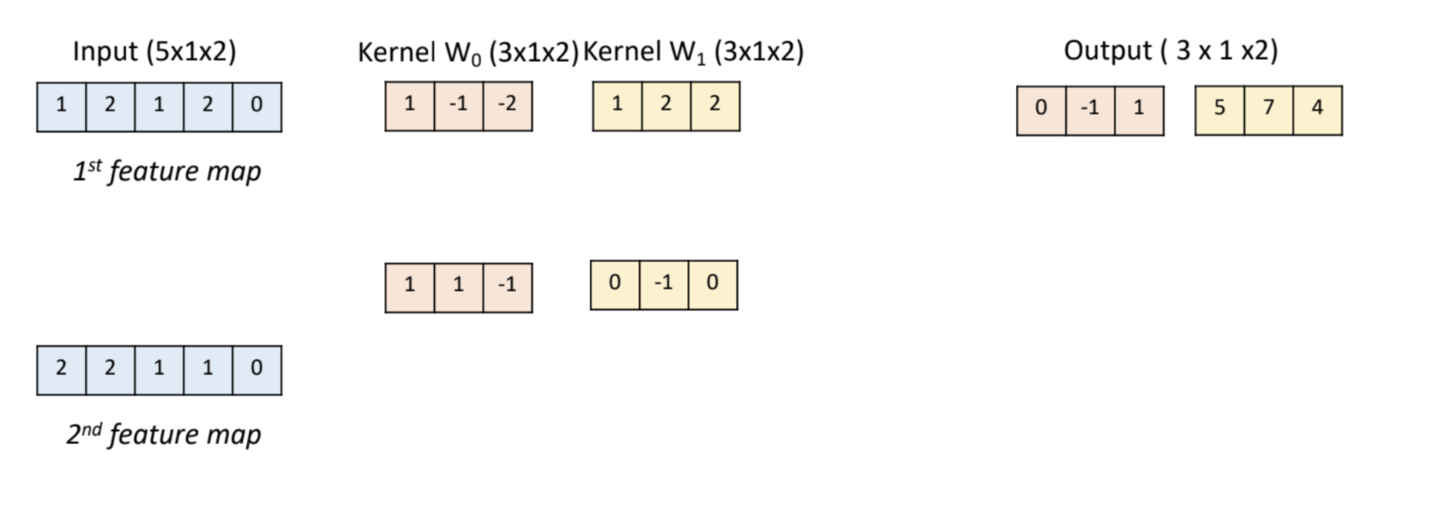

Slide 14
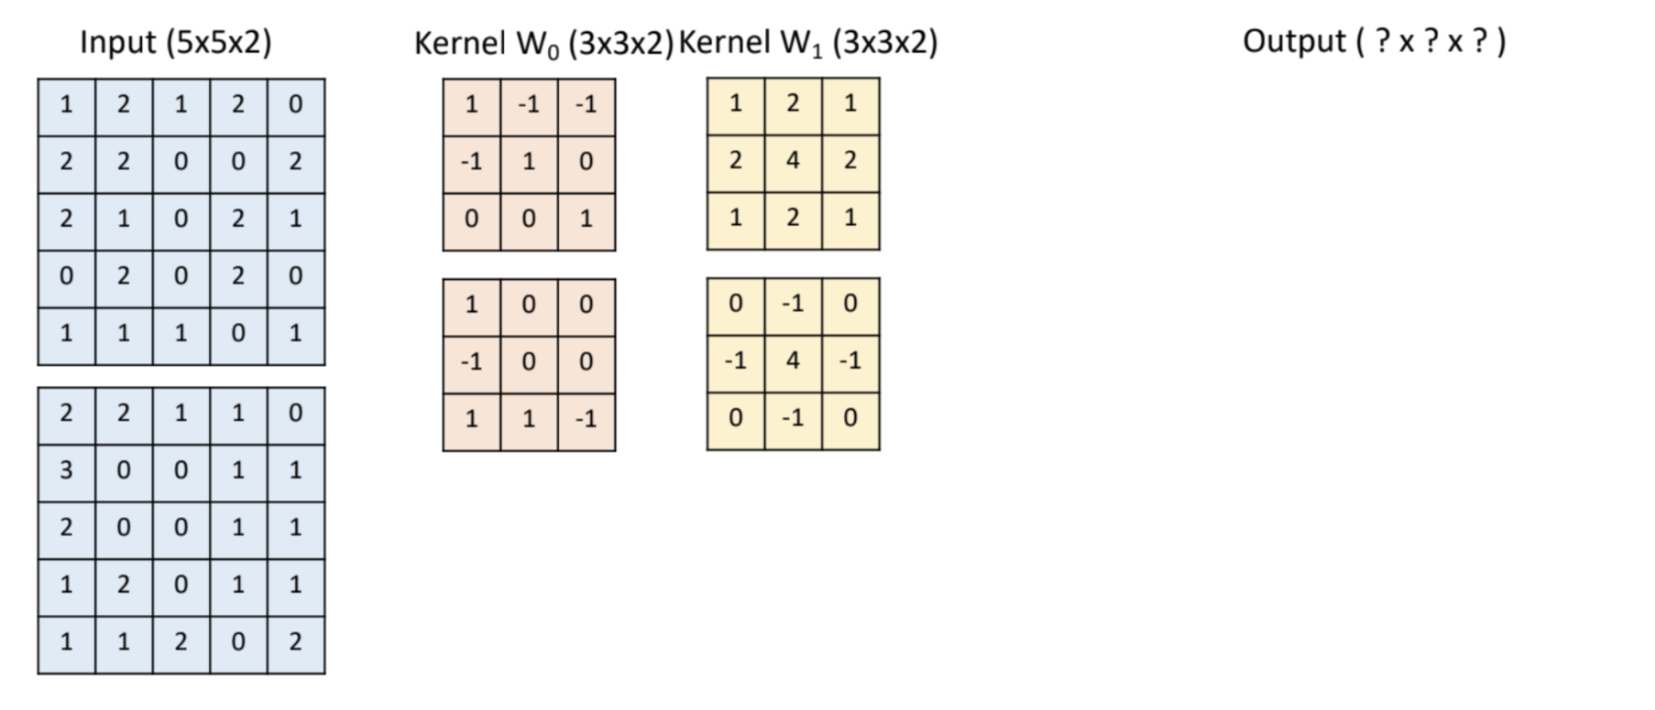

Slide 15
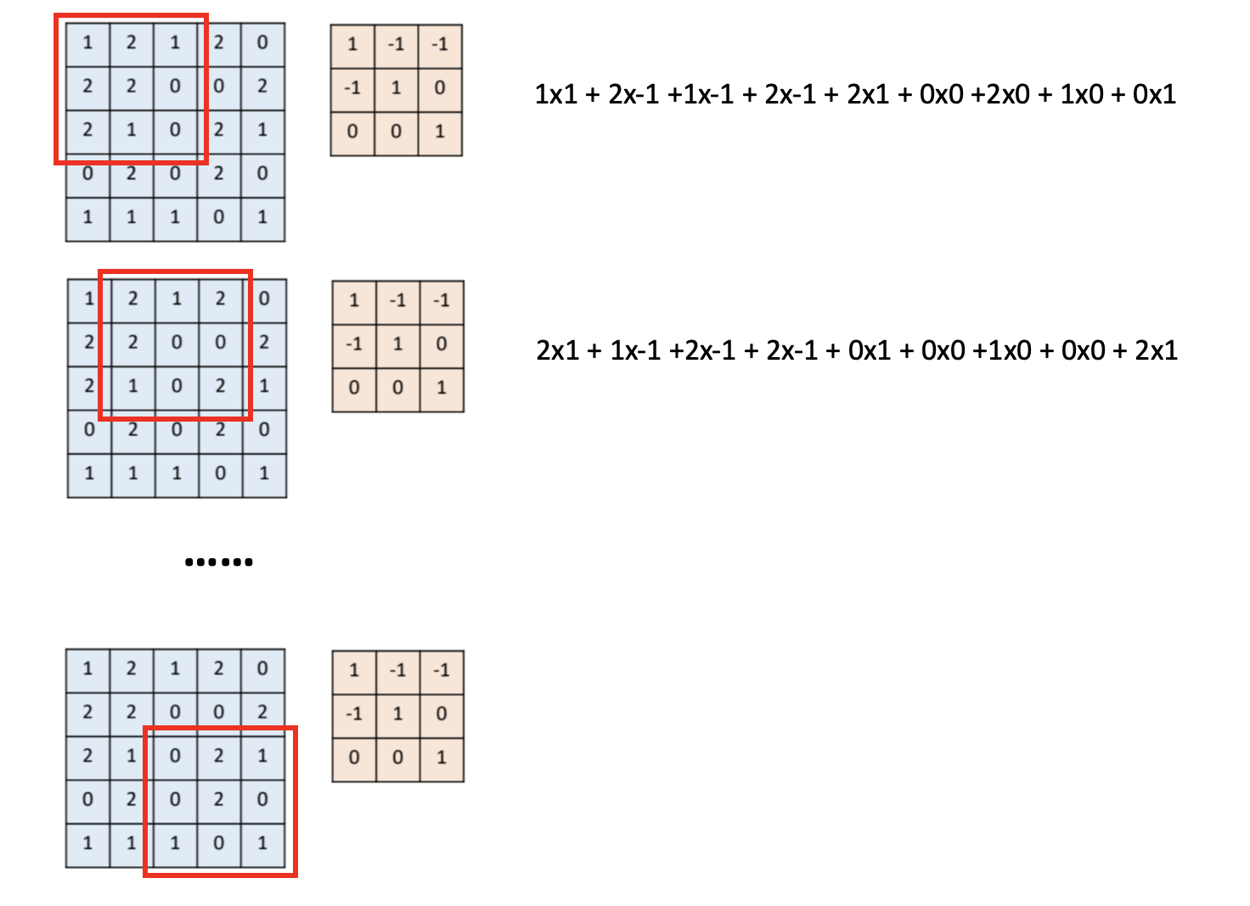

Slide 16
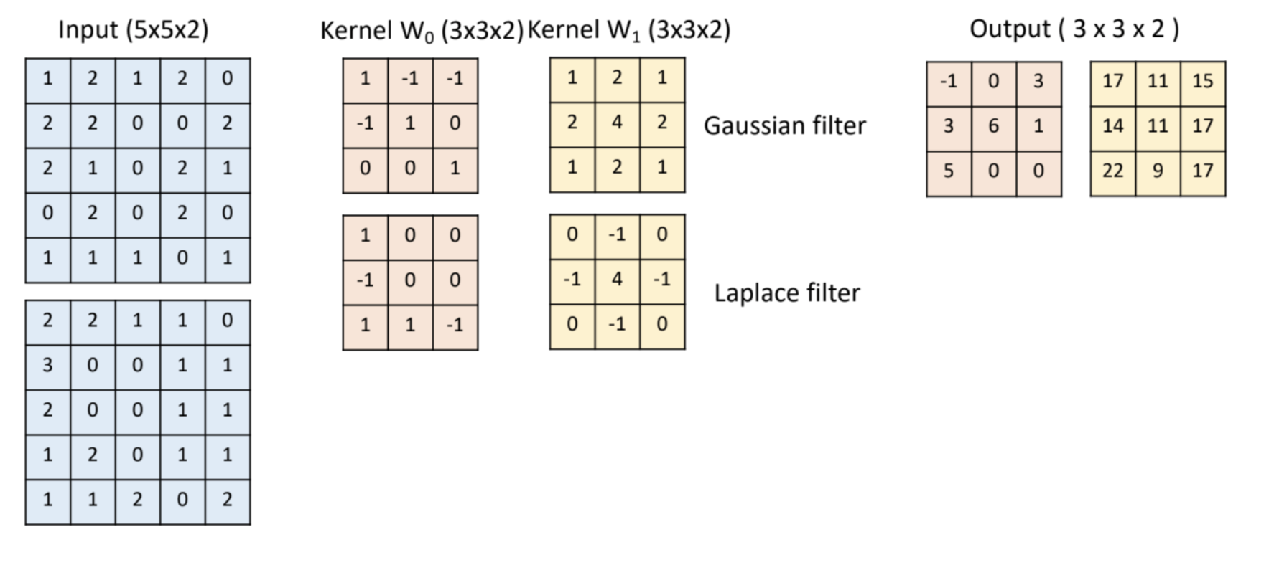

Slide 17
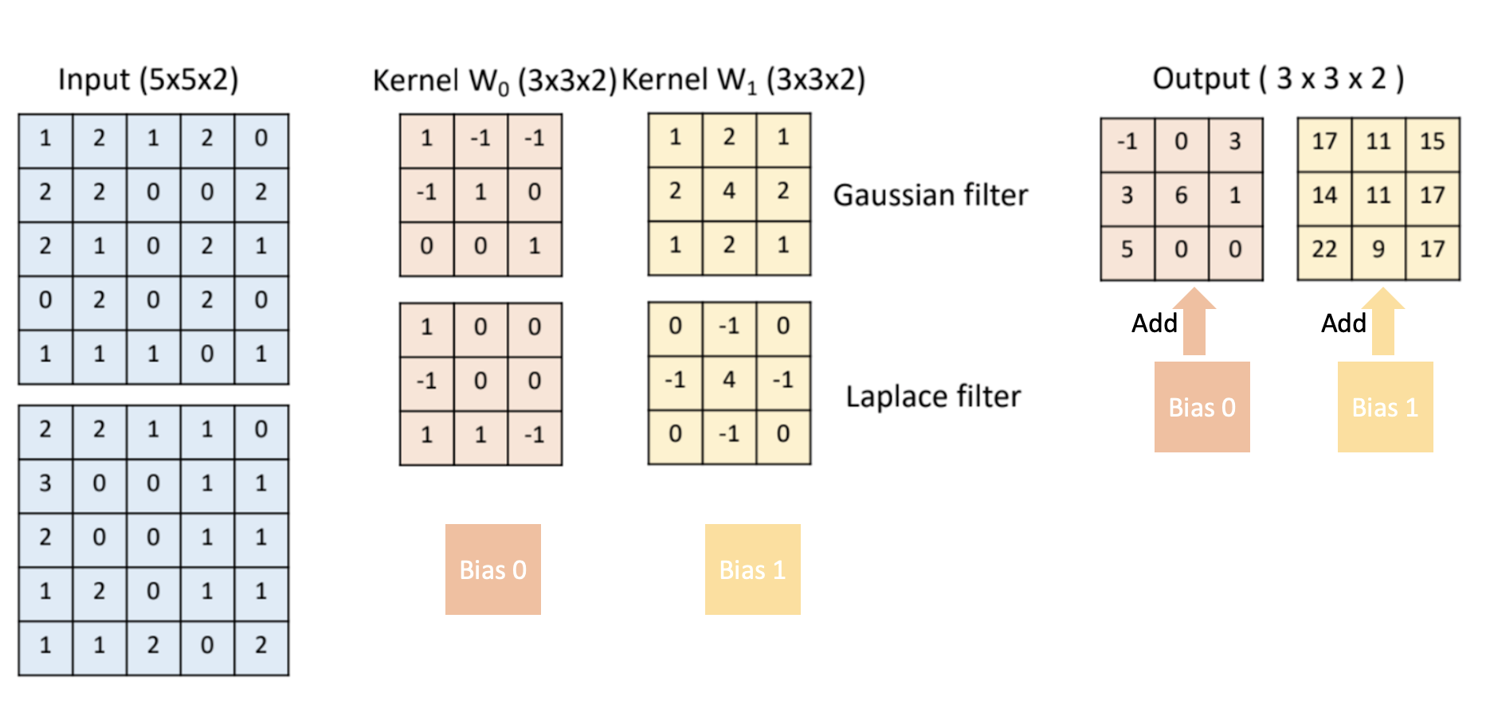
Notes:
5x5x5 x3(rgb)
5x5x5 x1(b/w)

